Slide 1
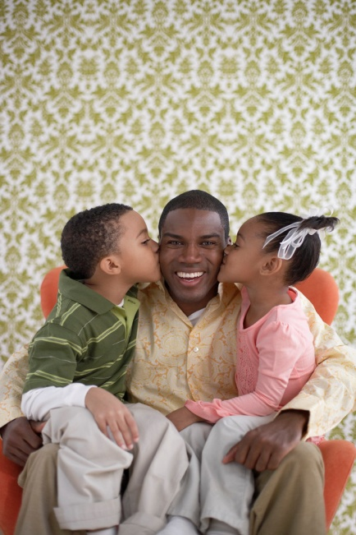


A Better Divorce Course
A Florida Department of Children & Families Approved Parenting Class for parents seeking a dissolution of marriage

Slide 2
Course Includes
The course promotes positive discipline.
How children feel about divorce.
The stages of loss and grief are presented in this guide.
The course addresses legal issues such as mediation and child support.

Slide 3
This Course is NOT
It is important to note, that this course is not designed for counseling purposes.
Also, this course does not provide legal information.
Disclaimer
“The components of the parenting course are intended for educational purposes only. The presentation of this material is not intended to constitute mental health therapy, give information on specific mental health disorders nor medications to treat mental health disorders. Participants are encouraged to discuss specific mental health questions with a licensed mental health therapist of their choice.”

Slide 4
Children’s Rights In A Divorce
Children have the right to be treated as individuals
Children have the right to not be a pawn or possession.
Children have the right to love their parents.
Children have the right not to be charged with making adult decisions
Children have the right to be emotionally supported during the divorce
Children have the right to be financially supported by both parents

Slide 5
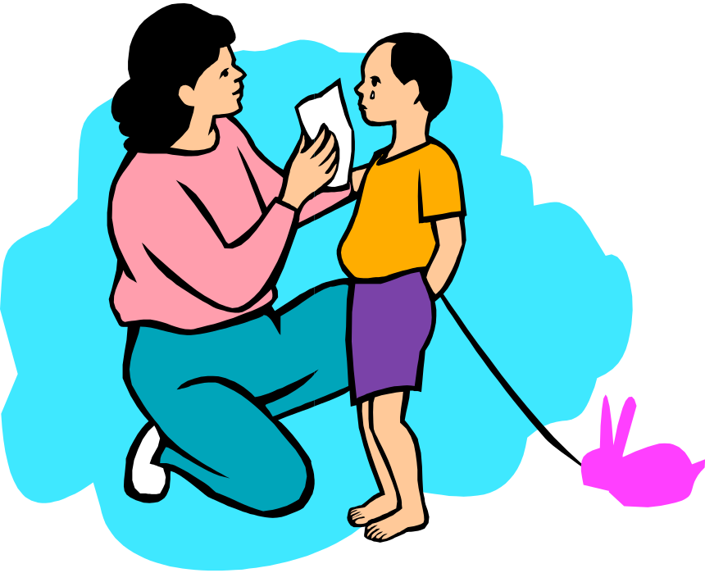
The Stages of Loss and Grief
Stage 1-Denial
Stage 2-Anger
Stage 3-Bargaining
Stage 4-Depression
Stage 5-Acceptance

Slide 6
How to Help your Child through the Stages of Loss and Grief
1. Do not argue with the other parent.
2. To the greatest extent possible, keep every other aspect of your child’s life the same and consistent.
3. Be on time when you come to pick them up from the other parent’s home.
4. Promote a healthy relationship between your child and the other parent.
5. Take care of yourself. If you take care of yourself then you will model effective habits for your children.

Slide 7
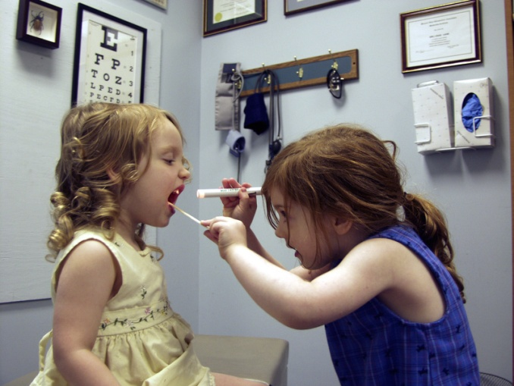
How Divorce Affects Children at different Developmental Stages
Infants 0 to 2
Toddlers 2 to 3
Preschoolers 3 to 5
School Age 6 to 10
Teens 11 to 14
Older Teens 15 to 18

Slide 8
Talking to Your Children about the Divorce
The best way for parents to tell their children about the divorce is in a quiet familiar home setting with both parents and all of the children present.

Slide 9
Divorce Guidelines
1. Plan what you are going to say before you say it.
2. Make sure that you are in control of your feelings.
3. Make sure that the entire family is present when you break the news about the divorce.
4. Make it clear right away that this was a decision that you’ve made.
5. Be aware that different children in the group will have different needs and will interpret things differently.

Slide 10
Talking to Children After They Know about the Divorce
Even if children have found out about the divorce by overhearing an argument and seeing a family member leave home, it is important to have a formal conversation with them.

Slide 11

Building Relationships

Slide 12
The Genuine Encounter
The Genuine Encounter is a technique that parents can use to improve their relationship with their children. The Genuine Encounter was created by Dorothy Briggs.
5 to 10 minutes
Child Leads
Meet Emotional Needs

Slide 13
The PRIDE Play Skills
The PRIDE Skills are a set of simple guidelines, presented by US Davis CAARE Center, that will help you to have positive interactions with your child and build a positive connection. These play skills are based on behavioral therapy and were presented by Dr. Sheila Eyeberg

Slide 14
The PRIDE Skills
5 to 10 minutes each day
Child leads play session
Shows your child that you are interested in what he/she likes
Help your child to develop key learning skills
Encourages your child toward self discipline

Slide 15
Promoting Healthy Relationships
Promote A Healthy Relationship Between Your Child and the Other Parent
Remember that your children are not divorcing the other parent. Therefore, they should not be allowed to have and further develop a positive relationship with the other parent.
Step Parenting
Parents may have concerns about dating after a divorce. Wanting to find someone to love after a divorce or separation is most natural. However, one must be aware of the emotional risks on children. If you have decided to start dating again please be cautious in regards to your children.

Slide 16
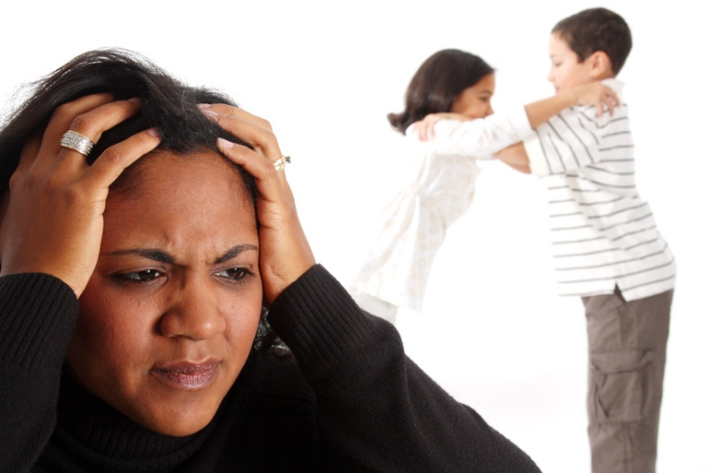
Why Children Misbehave
.
Children misbehave for a variety of reasons
Children DO NOT misbehave because they are “rude” or “just want to be bad”.

Slide 17
Providing Discipline
Contrary to what people may believe, children love rules, guidance and discipline. When you provide discipline for your child you are sending him that message that you care.

Slide 18
Best Practices
Family Dinner
Encouraging Positive Behaviors
Offer Praise
Eliminating Constructive Criticism
Role Model appropriate behaviors for your child
Reduce Conflict in your Home
Provide Consistency
Control Your Resources
Focus on Positive Behaviors
Know the 5 Positive Parenting Rules

Slide 19
The 5 Positive Parenting Rules
Rule 1: Clearly explain your expectations to your children.
Rule 2: Ignore inconsequential behaviors.
Rule 3: Selectively reinforce appropriate behaviors.
Rule 4: Stop then redirect inappropriate behavior.
Rule 5: Stay close to your children.

Slide 20
Seek Professional Help
Seek Professional Help
Sometimes it may be difficult for a parent to provide discipline for a child. You may find yourself, constantly punishing or arguing with your child. Maybe your child’s school is calling you on a regular basis to make complaints. Sometimes it may be that your child is outright non-compliant and disrespectful. Parents in this situation may begin to provide harsh punishments or give up on discipline altogether. If you are in a situation where you feel as though you are losing control, please reach out for professional help. The earlier you seek help, the more likely the intervention is to work.

Slide 21

CONFLICT RESOLUTION

Slide 22
Conflict Resolution
Here are some ideas you can use when talking to the other parent:
Use “I” statements.
Avoid words that are obsolete
Let the other parent know how their actions affected
Be aware of non-verbal behaviors
Focus in the current issue.
Focus on a solution.
Focus on a win-win solution.

Slide 23
DOMESTIC VIOLENCE
What is Domestic Violence?
Domestic violence, also referred to as intimate partner violence includes a pattern of behaviors that is used by one partner to obtain or retain power over the other partner.
Domestic violence can be physical abuse, sexual abuse, or emotional abuse.

Slide 24

Coping with a Divorce and/or Separation
Learn the Stages of loss and Greif
Who is your Support Team?
Take a Time Out
Read a Good Book
Enjoy a Cup of Tea
Go to a Massage Parlor
Get a Pedicure/Manicure
Have someone else prepare dinner
Take a yoga class
Watch your Favorite Movie
Take on a new Hobby
Make it a learning experience
See a Therapist/Counselor

Slide 25

THE GAMES PARENTS PLAY
The Mailman
The Secret Agent
The Hostage
The Therapist
The Negotiator
The Best Friend
The Mailman
The Secret Agent

Slide 26
Some indications of Intimate Partner Violence
⁪Your partner has hurt/threatened to hurt, your kids, family, friends, or pets
⁪Your partner breaks things and/ or throws when he/she gets angry
⁪Your partner frequently insults you in regards to your appearance
⁪⁪Your partner accuses you of looking at other people or being too flirty
⁪Your partner does things to scare you such as locking you outside at night
Your partner constantly corrects you, puts you down, or criticizes you.
⁪Your partner controls all the resources in the home such as food, money, telephones, television etc.
⁪Your partner isolates you from your family and friends and does not allow to work
⁪Your partner threats you as though you are an object during sex
⁪Your partner requests that you seek permission before agreeing to attend all and any events
⁪Your partner requires that you have his/her permission before you have any over or leave the home

Slide 27
CHILD ABUSE AND NEGLECT
Physical Abuse
Physical abuse is when a child is purposefully injured by another person.
Emotional Abuse
Emotional abuse is when a child’s social and psychological well being is damaged by the actions of another person.
Sexual Abuse
Sexual abuse is defined by any contact between a child and adult that is sexual..
Neglect
Neglect is when a parent or caregiver does not provide food, shelter, clothing, healthcare education and emotional support for a child.

Slide 28
What Makes a Good Co-Parent?
make decisions as a team.
put aside their differences for the benefit of their child/children.
do not put their emotional needs above their parental responsibilities
respectful toward each other.
support their child’s relationship with the other parent.
do not use their children as secret agents or as weapons.
share information with each other about their child’s life including activities and education..
adhere to the parenting plan.
able to compromise when necessary.
set rules and discipline procedures for their child as a team.
let each other know where, and with whom, their child will be at all times.

Slide 29
Parenting Plan
A parenting plan is a complete plan that includes a clear and understandable schedule of how the child/children will spend time with each parent. The schedule lists how weekdays, weekends, holidays, birthdays, vacation and other special days will be spent. It also contains who is accountable for school fees and health insurance. The plan also includes how each parent will be in touch with their child/children.

Slide 30

LEGAL ASPECTS ABOUT DIVORCE
Going to Court
Child Support
Alimony
Parenting coordination
Mediation

Slide 31
Mediation vs. Litigation
MEDIATION LITIGATION
Confidential
                Public Record
Informal
                Formal
You take the lead
                Attorneys lead
No witness needed
                Usually witnesses
Focus on future
                Focus on past
You decide outcome
                Judge decides
Less hostility
                More hostility
Less expensive
                Costly
Short process
                Lengthy process

Slide 32
Mediation Pledge
I pledge to support the use of mediation because it is generally quick, inexpensive, and allows individuals and organizations control in resolving their disagreements.
Florida Dispute Resolution Center

Slide 33

REFERENCES
Positive Discipline: 2006. Jane Nelson Ed.D. Ballantine Books.
PRIDE: Relationship Enhancement Strategies: 2004. Eyberg, S, McNeil, C, & Urquiza. UC Davis CAARE Center.
Special Time: Howard B.J., 2002. Guidelines for special time. Jelline, M., Patel, B., Froehlee, M., eds., Bright Futures in Practice: Mental Health-Volume II. Tool Kit. Arlington, VA: National Center for Education in Maternal and Child Health.
The Power of Positive Parenting:1994. Dr. Glenn I Latham. North Logan: P &T Parenting Prescriptions.

